Slide 1

Welcome!

Slide 2
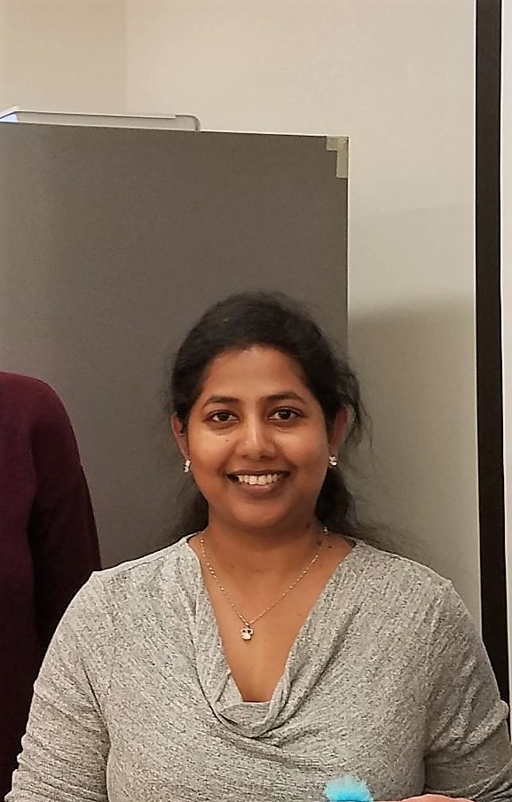
Kamal shree

Slide 3

Ratna Kishore

Slide 4
Agenda
Welcome Session
Roadmap
Timeline
Code of Conduct
Mentors
Connect
Support Details
Open-Source
Contributing Guidelines
Git & GitHub
Open-Source Tools
Open-Sorcerers
Open-Source Analysis
Community Management

Slide 5
Roadmap
Introduction on Application Development
Deep Dive into App Development - HarmonyOS
Contributing Guidelines
1
3
5
2
4
6
Introduction to libraries and Usage
Hands on Experience with HarmonyOS
Practice Exercises

Slide 6
Timeline
HarmonyOS Projects
Training Session
JAN
FEB
MAR
APR
MAY
JUN
JUL
AUG
SEP
OCT
NOV
DEC
Working on HarmonyOS

Slide 7
Code of Conduct
Respect
All participates & decisions
Encourage
Ideas and opinions
Sportsmanship
No abuse tolerated
Play
Have fun exploring
Educate
Educate and be knowledge
Conduct
Conduct yourself courteously
Trust
Treat everyone fairly

Slide 8
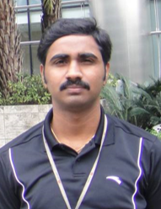

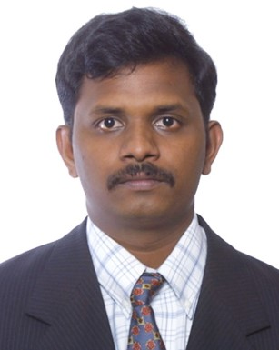
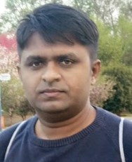
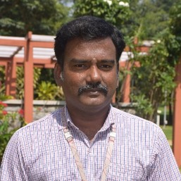
Mentors
Subba Reddy
Dev.subbareddy@gmail.com
Annu Bothra
Jain.annu15@gmail.com
Valluri Kumar
vkappenggroup@gmail.com
Sreenivasan. K
sreeramu@gmail.com
Kathirvel
rushtokathir@gmail.com

Slide 9



Mentors
Kamal Shree
kamalshree2784@gmail.com
Kanak Sony
kanaksony@gmail.com
Venkata Sreenivasulu
seenugvs82@gmail.com
Samuel Abhishekam
samuelabhishekamm@gmail.com

Slide 10
Connect
Slack
Twitter
Facebook
Medium
Youtube
Linkedin
GitHub

Slide 11
Connect
GitHub - https://github.com/applibgroup
Slack - https://applibgroup.slack.com/join/shared_invite/zt-n5yze4r7-xnwOeUv07Lw9rYMFHRSCjw
Medium - https://applibgroup.medium.com/
Twitter - https://twitter.com/applibgroup
YouTube - https://www.youtube.com/channel/UCbHrg3UTvtODxF-mEQMpfFQ
LinkedIn - https://www.linkedin.com/in/application-library-engineering-group-0115b7202/
Facebook - https://www.facebook.com/applicationlibrary.engineeringgroup
Meetup - https://www.meetup.com/application-library-engineering-group/

Slide 12
Support
info@applibgroup.dev
wilfy01@gmail.com

Slide 13

Open Source

Slide 14
“Managing an Open-Source project requires different demands on management and leadership.”

Slide 15
History
1950
1970
1990
1
3
5
Current
2
4
6
1960
1980
2000

Slide 16
Enterprise/Closed Projects
Everything is organized
No Risk, Secured
Support Ecosystem
Improved Functionality
User Friendliness

Slide 17


Slide 18
Did you know?
44% of the organizations to use open source as a rescue option.
48% cited the increasing efficiency of application development and maintenance as the reason for embracing open source.
Half have policies governing employee contributions to open source.
Around 40% of the organizations are shifting to open source.

Slide 19
Open Source
Creativity
Community
C
C
Flexibility
F

Slide 20
Share
Respect
Behavior
Report
Consequences

Slide 21
Contributing Guidelines

Slide 22
Join Slack
Code of Conduct
Development Guide
Environment setup
Design Document
Self Assessment
Contribute

Slide 23
GitHub

Slide 24
Git
Setup
Commands
README
Collaborate
Repository
Workflow

Slide 25
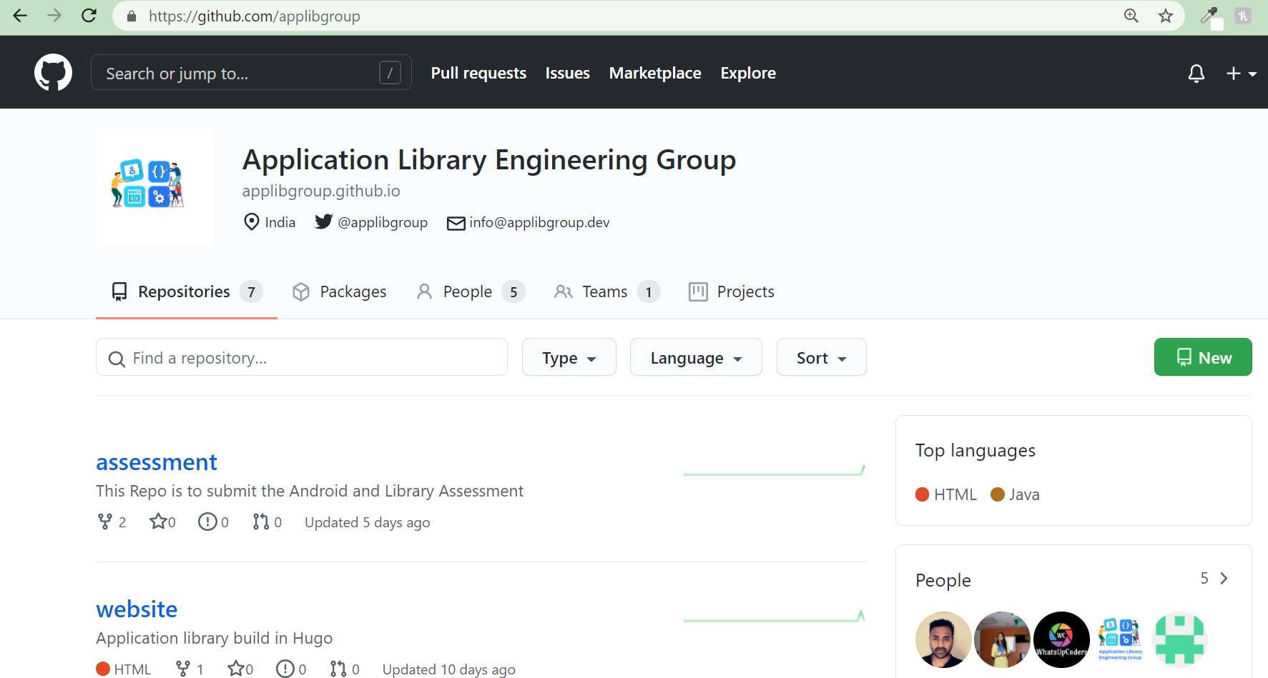

Slide 26
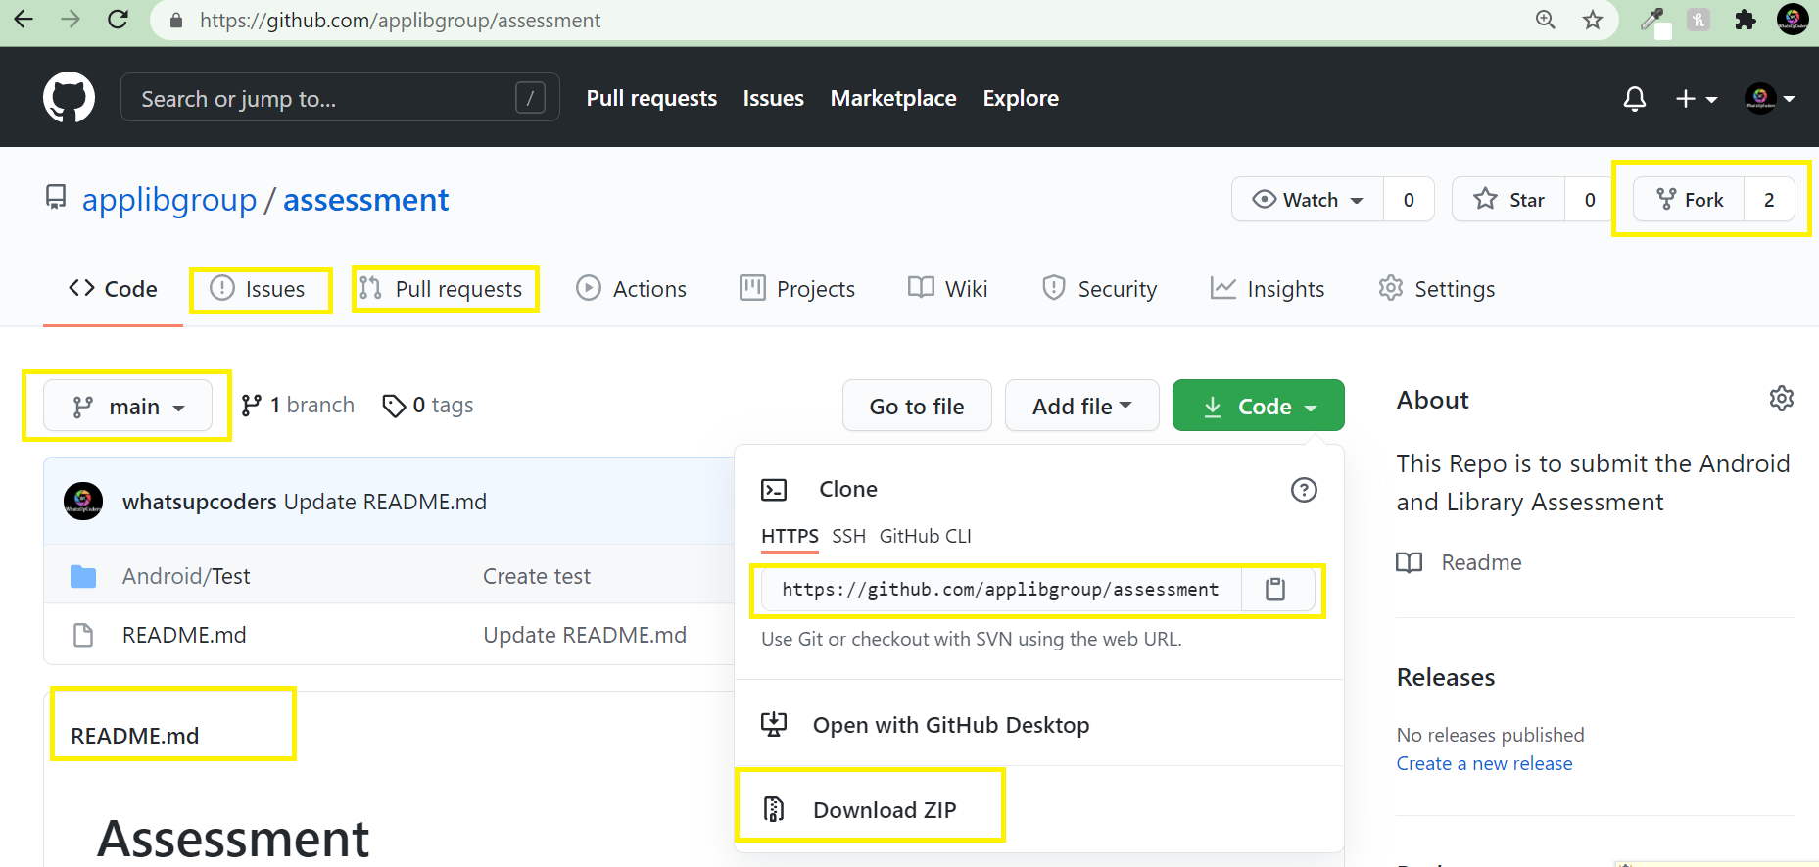

Slide 27
Steps to Contribute
Account
Create Branch
Document
Test
Submit
Project
Fork
Clone
Read
Set Environment

Slide 28
Open-Source Tools

Slide 29
Top Tools
Git
Bootstrap
Eclipse
.net
EMACS
Vim
Node.js
Cordova

Slide 30
Open Sourcerers

Slide 31
Contributor
Developer
Verifier
Approver
Project Lead

Slide 32
Open-Source Projects Analysis

Slide 33
Octoverse

Slide 34
56 Million+ total developers on GitHub
60 Million+ new repositories created in the last year
1.9 Billion+ contributions added in the last year
Whoa! That’s a big number, aren’t you proud?

Slide 36
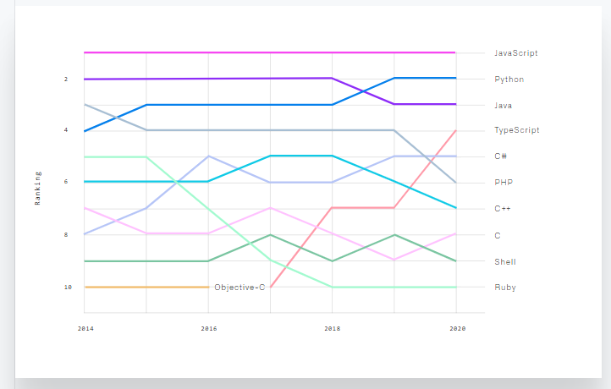
Top Languages over the years

Slide 37
Community Management

Slide 38
Community
Guidelines
Resources
Community profile
License
Labels
Code Conduct

Slide 39
THANKS!
Any questions?

